Slide 1
ClaimSphere – Test Automation
June - 2019

Slide 2
T3 ClaimSphere – Test Automation
Test Automation
Current Status & Plan
Interim demo of Clinical+ Prospective work flow
Interim demo of Hybrid work flow

Slide 3











ClaimSphere Automation Framework (CAF)
CAF is a framework for Behavior-Driven Development (BDD). It focuses on testing the features of product by defining the stories in scenarios that express the desired behavior in a textual format. A scenario is a collection of executable steps. In CAF it is expressed in Given, When, Then format.
Given step represents a precondition to an event
When step represents the occurrence of the event
Then step represents the outcome of the event
CI Based Execution – Jenkins
Execution platforms
Test Automation Tools
KEY HIGHLIGHTS
Page Object model driven approach Extends to enable BDD through integration with Cucumber Multi-Platform support - Windows / Linux
BENEFITS
Design scalability (through ease in test script reusability and maintainability) Execution scalability (through CI and BDD implementation)
Test Suite Repository
Driver Script
Browsers
Data Handler
Page object
Handler
Config Handler
Databases
Component Libraries
Utility Libraries
Functional & Business Libraries
OS
Error & Exception Handler
Reporting Libraries
Product Under Test
Reports

Slide 4
Current Status of completed modules / measures - Cont.
Workflow / Product | Module / Process | # Measures/Process Automated | Remarks
Retrospective Administrative Workflow / QaaS – Data Load Orchestration | Data intake Data Quality Cleansing Crosswalk Claim Adjustment Build Events Measure pre-processing Measure processing Results Tables Reports | Process Automated: Data intake Data Quality Cleansing Crosswalk Claim Adjustment Build Events | Scenarios not yet started.
Retrospective Administrative Workflow / QaaS – Measure Engine | HEDIS Measure Engine | 83 – 2019 measures | Automated
Retrospective Administrative Workflow / QaaS Prime – Measure Engine | HEDIS Measure Engine | 83 – 2019 measures | Automated
Retrospective Administrative Workflow / P4P – Measure Engine | P4P Measures | 22 – 2019 measures | Automated

Slide 5
Current Status of completed modules / measures
Workflow / Product | Module / Process | # Measures/Process Automated | Remarks
Prospective Measurement Workflow / Clinical+ Provider Registry | Data Load in QaaS (Pre requisite for Clinical+) Data Import in Clinical+(Admin) Project Creation(Admin) Abstractor and reviewer Assignment(Admin) Data Abstraction (Measure Logic) (Abstractor) Reviewing abstracted data (Reviewer) Pseudo claim Generation(Admin) Incremental data load to QaaS Compliance Validation in QaaS | 9 processes automated from framework perspective. Feature Files completed for 2 out of 54 measures | ABA, SPD completed. Feature Files for 52 Measures in-progress
Hybrid Measure work flow / Clinical+ Hybrid Reporter | Hybrid Sampling Process Hybrid Sampling approval process Hybrid Chase generation process Medical record processing Admin Data Refresh process Admin Data Refresh (NRDR) chase generation process Hybrid Regeneration process Hybrid Regeneration Incremental chase generation process | 1 out of 16 hybrid measures Admin Data Refresh yet to automate Other processes automated | PPC measure automated (Notification date scenario is yet to automate)

Slide 6
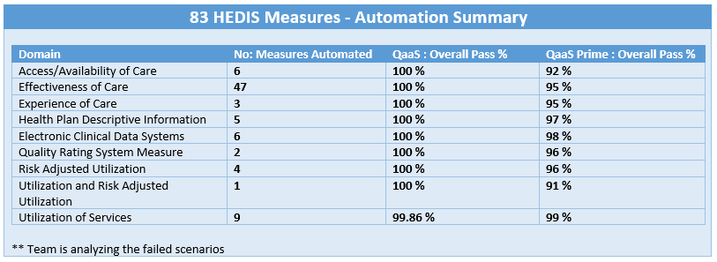
Retrospective Administrative Workflow / Measure Engine
Successfully completed functional automation of 83 HEDIS measures (2019 Season) comprising of around 6000+ scenarios each for both the stacks (QaaS & Prime).
Test Automation Integration in CI pipeline - Standalone Completed, WIP for CI Integration (Weekly Run - > 90% is getting achieved)

Slide 7
P4P – Measures
Successfully completed functional automation of 20 P4P measures (2019 Season) out of 24 measures
S.No | Name | PO |  |  |  |  |  | MCO
 |  | Total | Passed | Failed | Pass % | Automated |  | Total | Passed | Failed | Pass % | Automated
1 | PAAB | 75 | 75 | 0 | 100% | Y |  | 101 | 101 | 0 | 100% | Y
2 | PABA | 33 | 33 | 0 | 100% | Y |  | 39 | 39 | 0 | 100% | Y
3 | PAMR | 66 | 66 | 0 | 100% | Y |  | 78 | 78 | 0 | 100% | Y
4 | PART | 106 | 106 | 0 | 100% | Y |  | 118 | 118 | 0 | 100% | Y
5 | PBCS | 143 | 143 | 0 | 100% | Y |  | 161 | 161 | 0 | 100% | Y
6 | PCBP | 91 | 91 | 0 | 100% | Y |  | 118 | 118 | 0 | 100% | Y
7 | PCBPH | 48 | 48 | 0 | 100% | Y |  | 75 | 75 | 0 | 100% | Y
8 | PCCO | 63 | 63 | 0 | 100% | Y |  | 64 | 64 | 0 | 100% | Y
9 | PCCS | 35 | 32 | 3 | 91% | Y |  | 52 | 52 | 0 | 100% | Y
10 | PCHL | 50 | 50 | 0 | 100% | Y |  | 67 | 67 | 0 | 100% | Y
11 | PCWP | 61 | 61 | 0 | 100% | Y |  | 77 | 77 | 0 | 100% | Y
12 | PIMA | 53 | 33 | 20 | 62% | Y |  | 83 | 53 | 20 | 72.60% | Y
13 | PLBP | 37 | 37 | 0 | 100% | Y |  | 55 | 55 | 0 | 100% | Y
14 | POMW | 138 | 138 | 0 | 100% | Y |  | 154 | 154 | 0 | 100% | Y
15 | PPDC | 61 | 61 | 0 | 100% | Y |  | 81 | 81 | 0 | 100% | Y
16 | PSPC | 172 | 172 | 0 | 100% | Y |  | 196 | 196 | 0 | 100% | Y
17 | PSPD | 226 | 226 | 0 | 100% | Y |  | 254 | 254 | 0 | 100% | Y
18 | PCIS | 136 | 136 | 0 | 100% | Y |  | 184 | 184 | 0 | 100% | Y
19 | PCOL | 133 | 133 | 0 | 100% | Y |  | 153 | 148 | 5 | 96.73% | Y
20 | PSUPD | 34 | 34 | 0 | 100% | Y |  | NA | NA | NA | NA | N
21 | PCDC |  |  |  |  | N |  |  |  |  |  | N
22 | PENRST |  |  |  |  | N |  |  |  |  |  | N

Slide 8
Retrospective Administrative Workflow / QaaS – Data Load Orchestration
Intake of health plan’s administrative data received in ClaimSphere QaaS specified file format and load into Stage
Rules to profile the errors in administrative data (DQ Rules)
Set of rules to validate and identify invalid records (Cleansing Rules)
Crosswalk to convert home grown codes to Standard codes
Customer specific transformation rules to handle different claim scenarios arising out of claim adjustments
ClaimSphere QaaS engine to run the certified measures to generate measure rates and related details to be used downstream for reporting and analytics.
Reports to understand the health plan performance
Provider attribution logic to map the member with corresponding PCP
Reports to meet the regulatory requirements

Slide 9
ClaimSphere HEDIS Input Files
Membership General
Membership Enrollment
Member's PCP
Member Delivery
Visit
Pharmacy
Lab Observation
Provider
Provider Info
Supplemental
Customer
ETL
Pre-processing
3
HEDIS Engine
File to stage
Data Quality
Cleansing
5
1
2
Claim Adjustment
Cross walk
4
Build events
(code map)
6
Measure
5
9
Results table
QOC
HAI
HEDIS Measure engine
9
Pharmacy
Claims
Qualify
Traceability
Provider attribution
Report Summary
7
8
UOS
RRU
RAU
10
11
12
13
Hybrid RateGen
Automatic/Manual Data Refresh
9
5
Sampling
HEDIS to Hybrid
[Sample member details]
Chase
generation
Chase request
Chase response processing
18
Hybrid rate
generation
Customer/
MRR Vendor
9
14
15
16
17
19
Post Process – Analytics & Reports
Post Process - Regulatory Submission
Post Process - Outbound Files
10
12
5
13
5
9
Reports
8
19
Performance Trending
2
DQ Report
Hybrid measure rate
19
8
Member level details
C
C
9
IDSS
2
DQ Profiling
Report
Measure scorecard
C
Hybrid member details
19
PLD
Chase request files
Member – PCP attribution
4
Data load statistics
C
ClaimSphere Dashboard
5
C
Sampled member compliance
17
Provider address
Provider scorecard
8
Measure rate report
S
9
CAHPS
17
C
Chase
Gaps in care
8
Supplemental report
(Impact & summary)
Chase member -provider detail
10
NR event file
C
S
16
QHP
Member visits
Cockpit Std. reports
Std. Reports generated thru scripts
C
S

Slide 10
Hybrid Measure work flow / Clinical+ Hybrid Reporter
Hybrid Sampling Process
Hybrid Sampling approval process
Hybrid Chase generation process
Medical record processing
Admin Data Refresh process
Admin Data Refresh (NRDR) chase generation process
Hybrid Regeneration process
Hybrid Regeneration Incremental chase generation process
16 Hybrid measures to be completed from feature files perspective
Interim demo of completed process

Slide 11
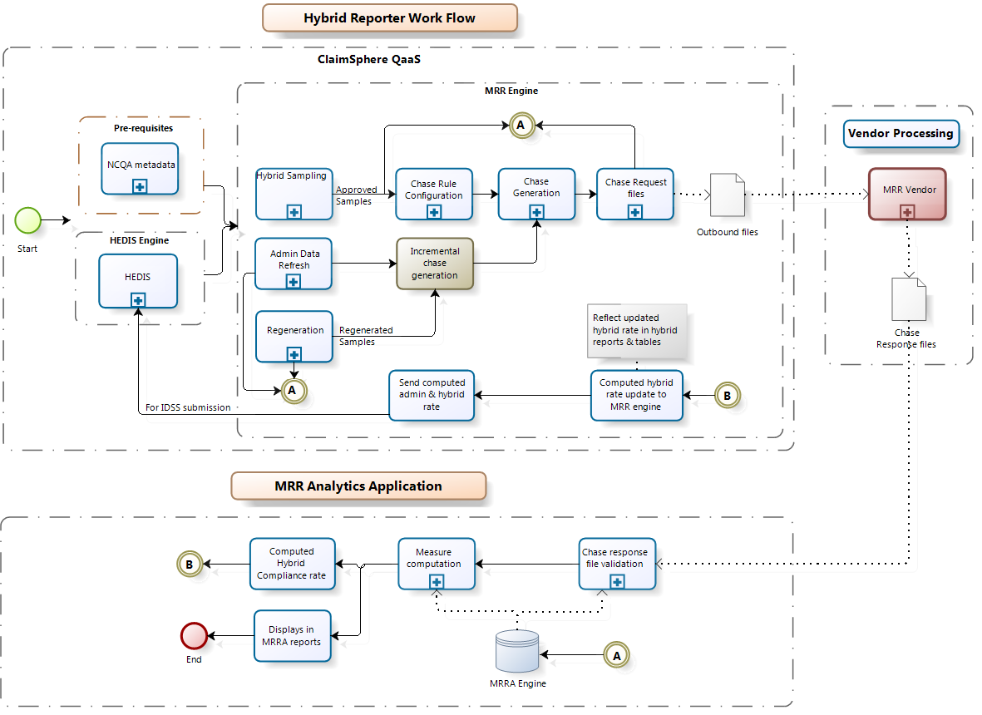

Slide 12
Prospective Measurement Workflow / Clinical+ Provider Registry
Data Load in QaaS (Pre requisite for Clinical+)
Data Import in Clinical+(Admin)
Project Creation(Admin)
Abstractor and reviewer Assignment(Admin)
Data Abstraction (Measure Logic) (Abstractor)
Reviewing abstracted data (Reviewer)
Pseudo claim Generation(Admin)
Incremental data load to QaaS
Compliance Validation in QaaS
54 measures to be completed from feature file perspective
Interim demo of completed process

Slide 13
Clinical+ Prospective Process
1
ClaimSphere QaaS
2
Clinical+ Data Intake
3
Project Creation
4
Care Gap Assignment
5
Measure Abstraction forms &
Rule Processor Engine
7
Provider Scorecard
8
Report Generation
6
Abstraction Review
9
Pseudo Claims Generation

